Slide 1

GREEN
Think Clean, Live Green
Graduation Project 2022 - 2023

Slide 2
Team Members
Name |  |  |  |  |  | ID
Mohamed Samy Elgabry |  |  |  |  |  | 20190441
Zeyad Ahmed Hamed Mohamed |  |  |  |  |  | 20190215
Alaa Sabry Mohamed |  |  |  |  |  | 20190177
Hassan Ragab Hassan Bakr |  |  |  |  |  | 20190335
Mohsen Mohamed Mahmoud |  |  |  |  |  | 20190412
Supervised By :
Dr. Laila Abdelrahman Mohamed
TA. Nourhan Hussein

Slide 3
Agenda
Introduction
Problem statement
Objectives
Related work
Project Specifications
Methodology
Timeline
Prototype

Slide 4
Introduction
Green aims to create a more environmentally lifestyle platform that makes it easy for individuals and communities.
The platform includes a variety of features such as a booking system for trusted gardeners, shopping for high-quality, eco-friendly products, personalized advice and recommendations from expert advisors, plant care recommendations, and reminders to help users stay on track with their sustainability goals.
We believe that Green has the potential to make a significant impact in our community and beyond by empowering individuals to take meaningful action towards a greener lifestyle.

Slide 5
Problem Statement
Limited access to trustworthy Gardeners
gardeners struggle to find enough clients and increase their income.
It is not easy to find answers accurately and quickly about what is related to plants and agriculture.
Difficulty to buy and search for specific plants with specific characteristics.
There is no single platform that provide all this functionalities in one app to help the users who searches for a greener lifestyle in one place.

Slide 6
Objectives
Book Gardner
Plant Disease Identifier
GREEN
Shop Products
Reminder
Tips
Learn more about plants
Ai Chatbot Assistant

Slide 7
Related Work
Point of comparison | GardenTags | Gardroid | Alyaseen Agri | Green
Booking a Gardener |  |  |  | ✔
Shop Products |  |  | ✔ | ✔
AI Chatbot |  |  |  | ✔
Reminder |  |  |  | ✔
Tips |  | ✔ | ✔ | ✔
Learn about plants |  | ✔ | ✔ | ✔
Community Help | ✔
To-Do List | ✔

Slide 8
Project Specifications
Functional Requirements
Non-Functional Requirements
Methodology, Technologies
Architecture Diagram
Use Case Diagrams
Sequence Diagrams
Prototype

Slide 9
Functional Requirements
customer | GARDENER | Admin
Registration and Login | Registration and Login | View Earnings
Search Service | View incoming requests | Manage Users
Give a Rate | View Pending/accepted requests | Manage Products
Shop for Products | Chat with Customer | Manage Gardeners
Book a Gardener | Accept/ Reject Requests | Manage Orders
Creating & Editing Profile | Creating & Editing Profile | Manage Categories
View Plant Care Tips |  | Send Notifications
View Learn About Plants
Chat with Ai chatbot assistant

Slide 10
Non-Functional Requirements
Availability
Scalability
Performance
Compatibility
Maintainability
Usability
Reliability
Security

Slide 11
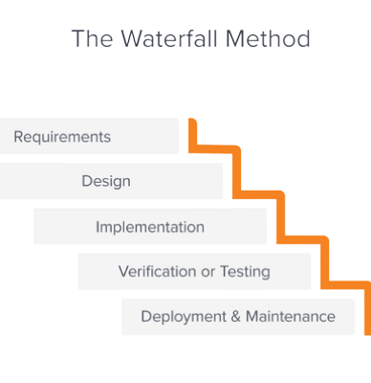
Methodology
Technologies & Tools
Flutter and Dart Firebase Pycharm Flask (python) TensorFlow Deep Learning Android Studio VS Code GitHub, Git

Slide 12
System Architecture

Slide 13
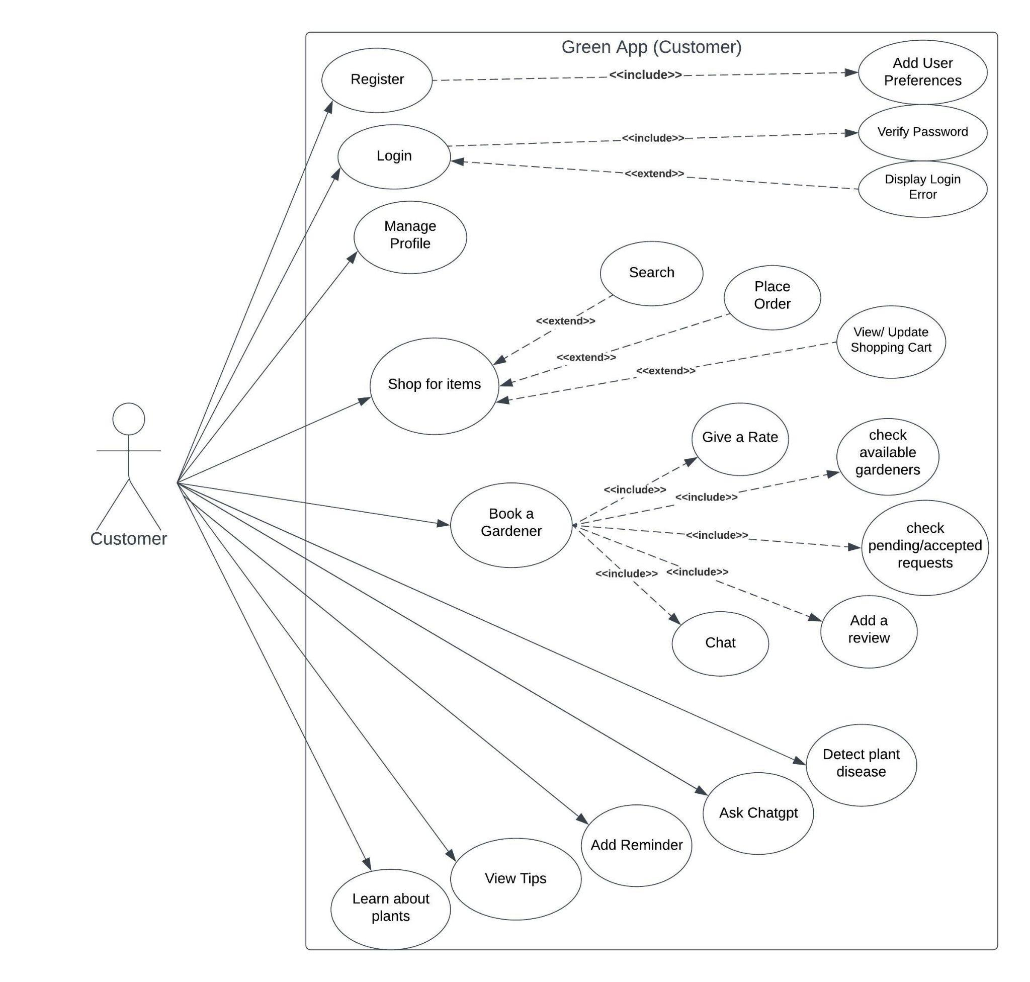
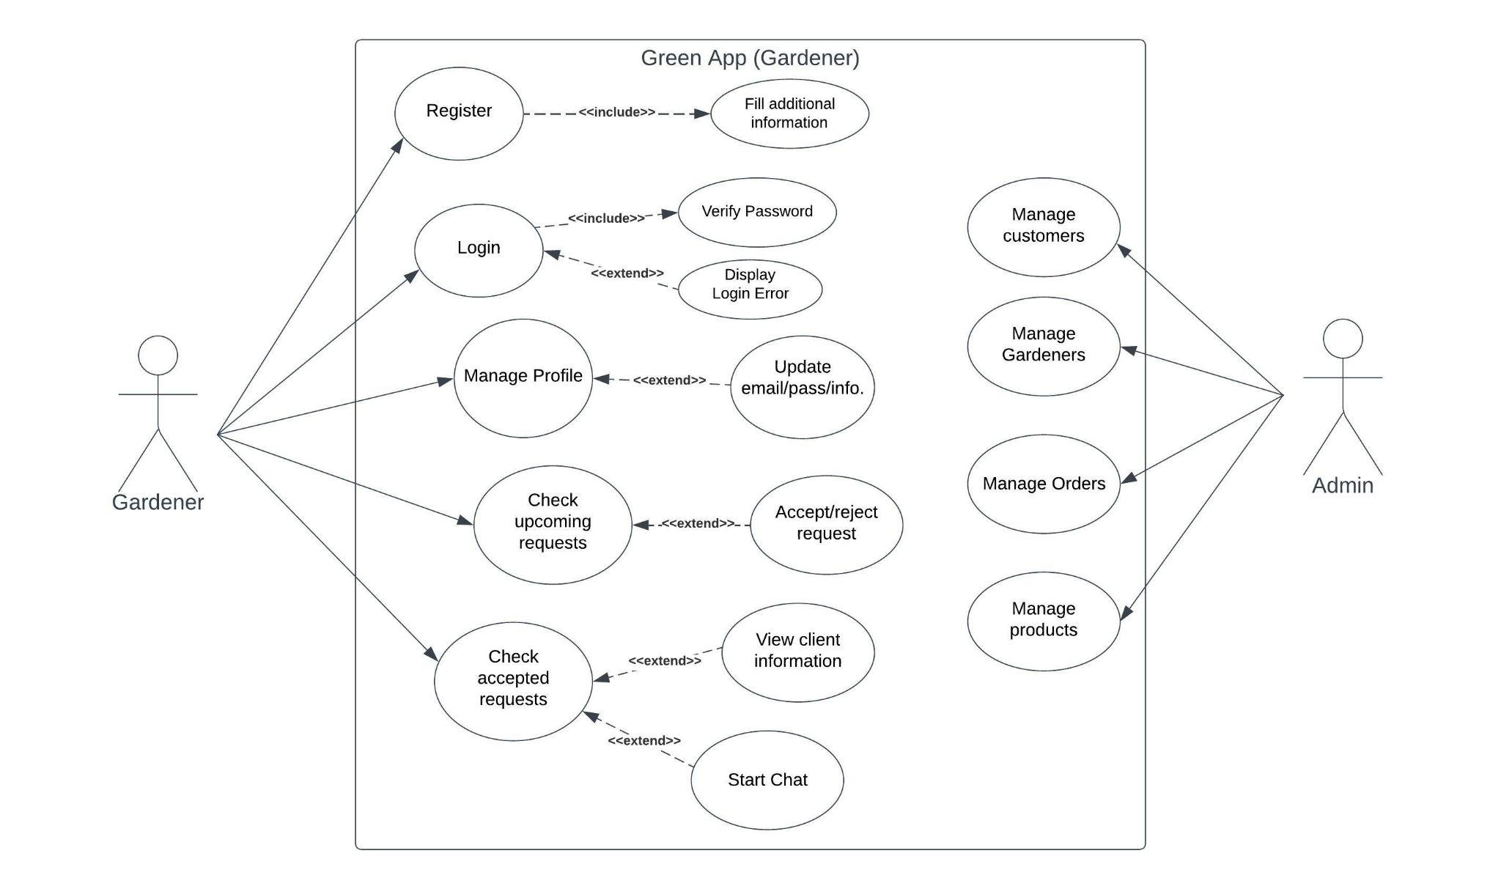
Use Case Diagrams

Slide 14
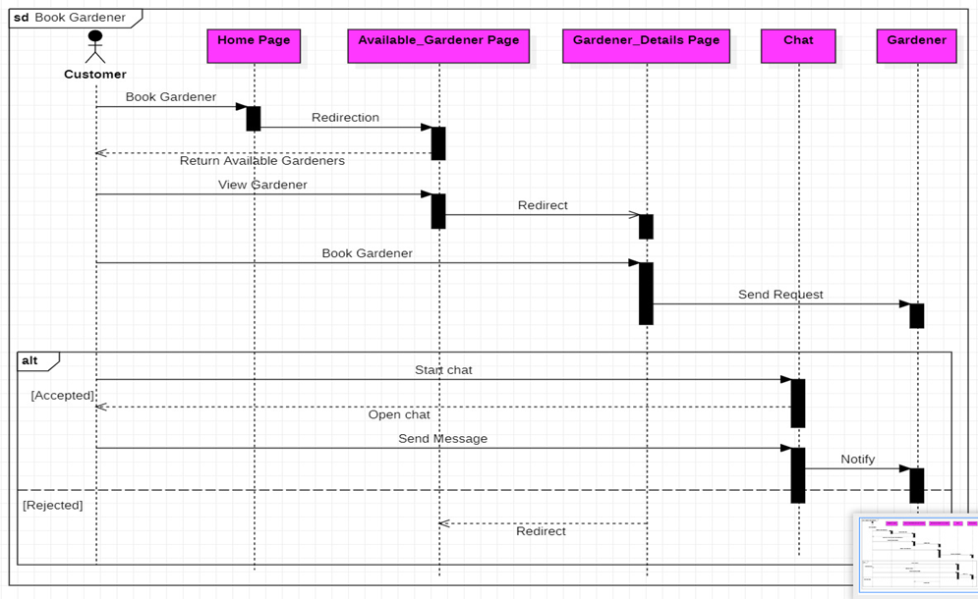
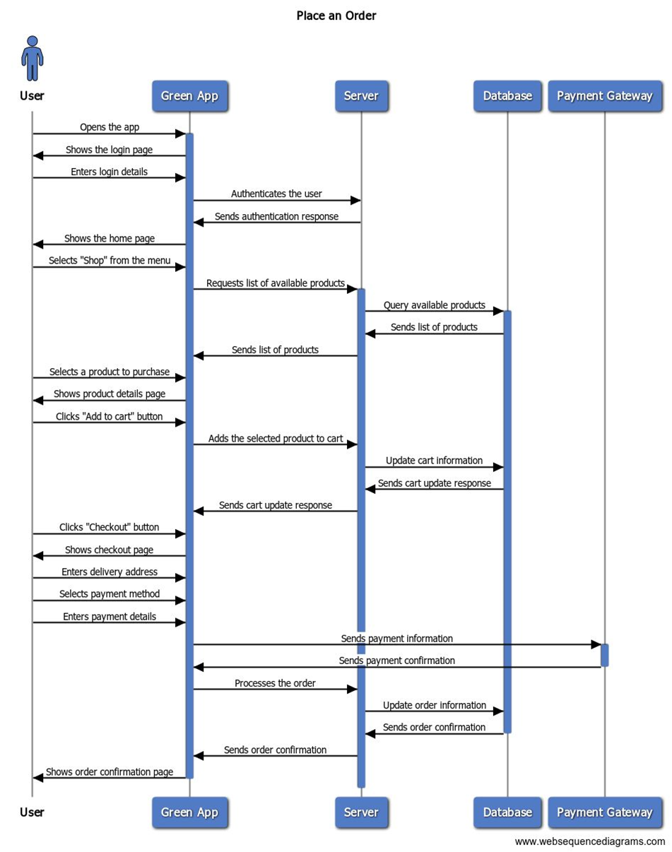
Sequence Diagrams

Slide 15
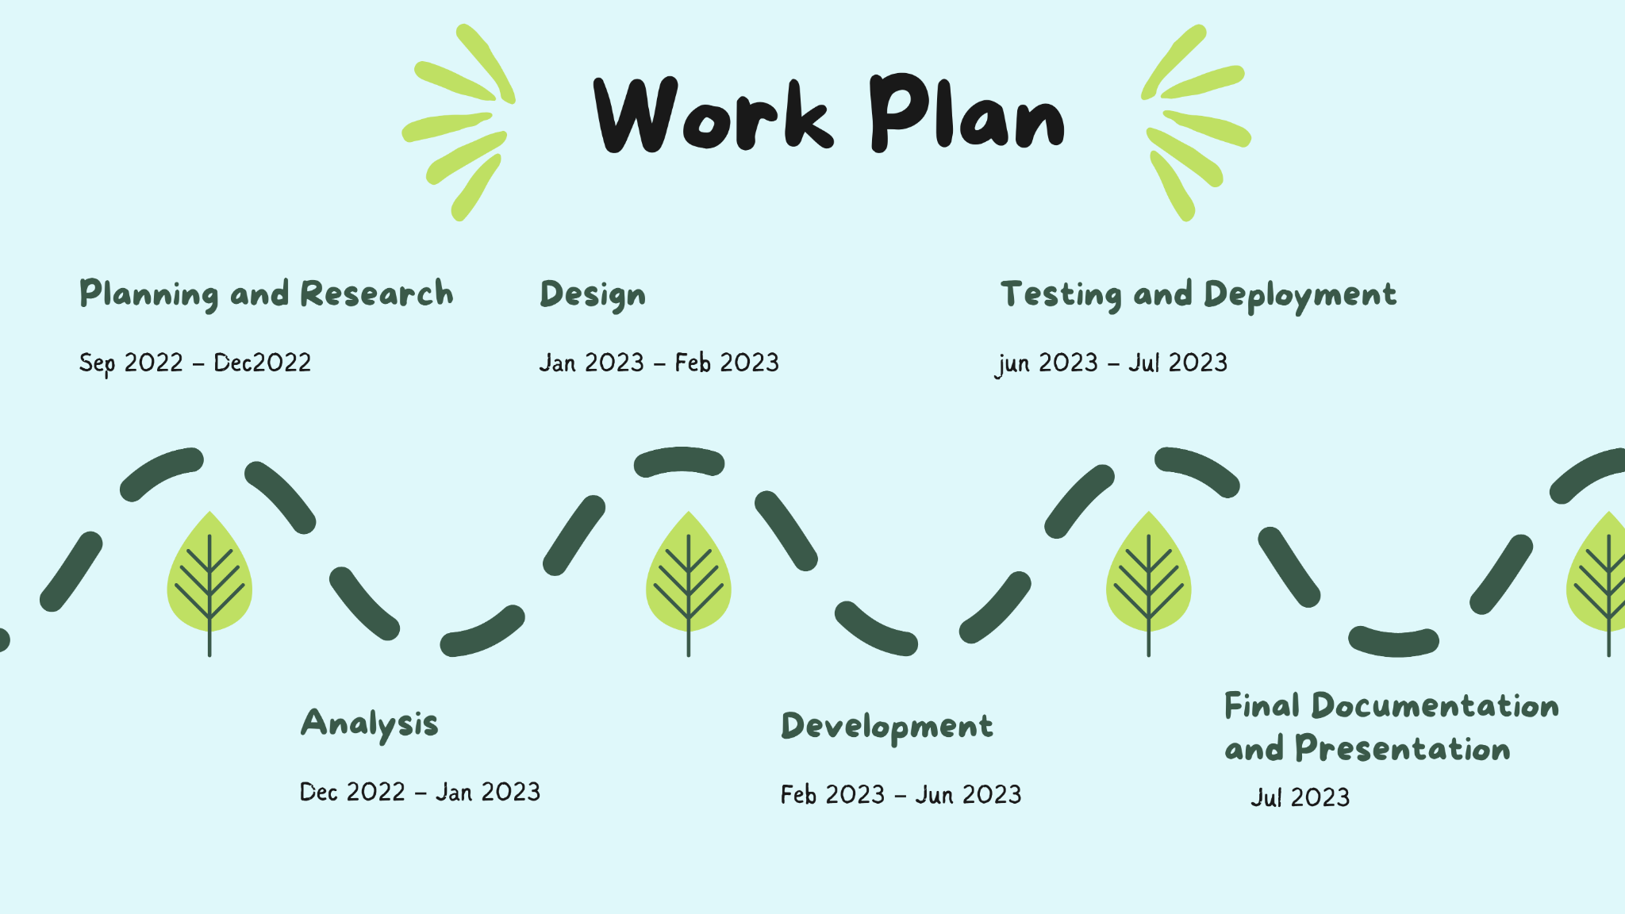
Work Plan

Slide 16
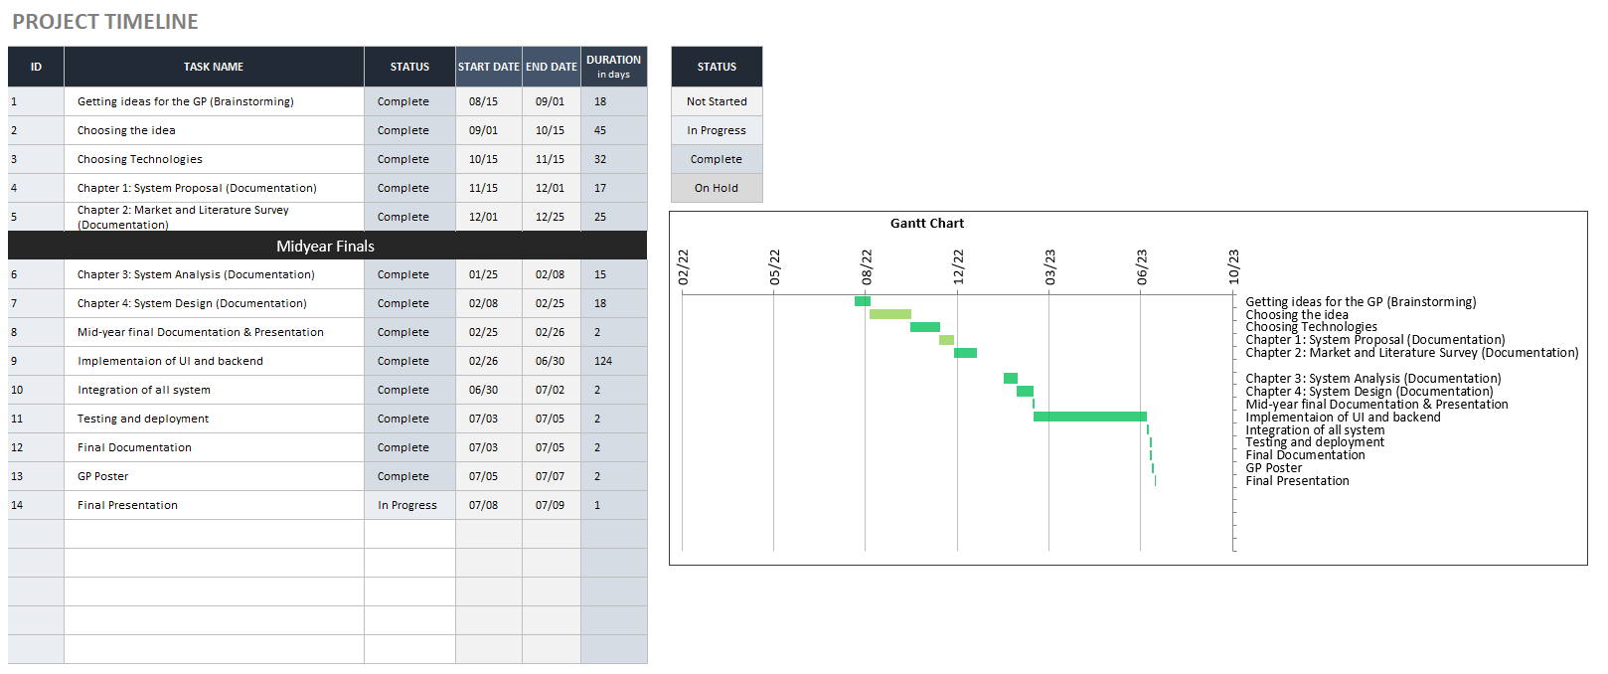
Time Plan

Slide 17
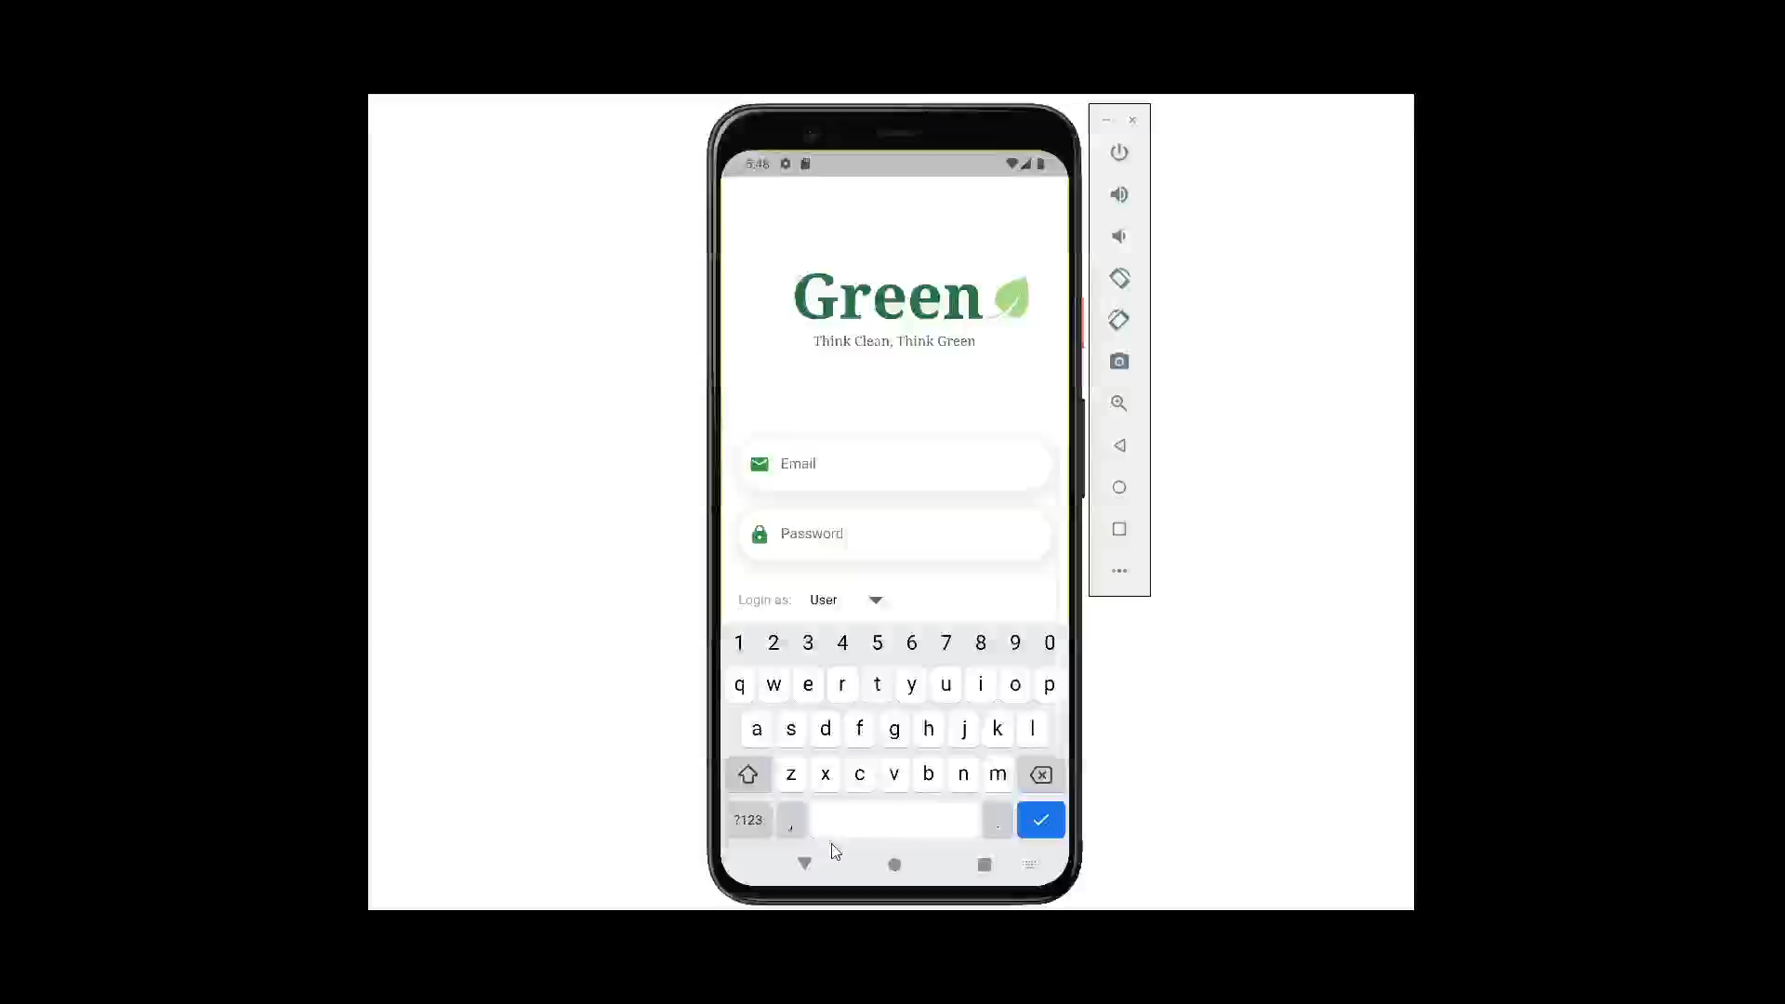
Prototype

Slide 18
Future Work
Community Collaboration
Integrate with trusted companies
Future Work
Plant Identifier
Through API

Slide 19
Conclusion
01
G
Supermarket, superman, supernatural, supernormal, superstar, supersonic, superscript
02
R
Mini mart, miniskirt, mini stadium, minibus, minivan, minimalist, mini-series
03
E
Hyperactive, hyperventilate, hypersensitive, hyperinflation, hypermarket, hyper-modern
04
E
Overloaded, oversize, over bloated, overgeneralise, overcharge, overdue, oversimplify
05
N
Outnumber, outspoken, outsmart, outwitted, outrun, outgoing, outlast, outlive, outgrow

Slide 20
THANK YOU
Any questions?

